Slide 1
POINTERS

Slide 2
Pointers
simply memory addresses
Already used with arrays passed as parameters – always reference variable reference variables are actually pointers
Name of an array returns the address where the array is stored in memory. i.e. a pointer to the array.
int x[10];
500 504 508 512 536
500 int x [ 0 ][1 ][ 2] [3][ 9]

Slide 3
Pointers
int x[100];
X[25] = 6; // compiler computes this as address + offset // if int is 2 bytes and x is stored at address 2000 then // 2000 + (25*2) = 2050 is the address of x[25]
// and integer 6 is stored in that memory location

Slide 4
Pointers
new data type called pointer since memory can contain different types(and sizes) of data we include the data type as part of pointer declaration int 2 bytes long 4 bytes double 4 bytes char 1 byte struct ? bytes (depends on struct definition)
Declaring a pointer: add pointer notation (*) between data type and variable name int * iPtr; char * chPtr; long * lPtr; student * stPtr; float * f;

Slide 5
Pointers
int * ptrMyVar; //automatically initialized to nullptr //equivalent to zero or ‘\0’ int *ptrMyVar, myVar; //declares one int pointer and one int variable
int*ptrMyVar; //these 4 statements are identical int *ptrMyVar; //whitespace is for humans int* ptrMyVar; int * ptrMyVar;

Slide 6
Pointers
& and *
* is dereference operator
& is reference operator //look familiar? pass by reference notation? int myVar, * ptrMyVar; //value will always be memory location containing an int myVar = 8; ptrMyVar = &myVar; //store address of int variable myVar *ptrMyVar = -1; //value at memory address value is assigned value -1 cout << myVar; //displays -1 cout << *ptrMyVar; //displays -1

Slide 7
Pointers
dynamically allocate memory using new: new int; //returns memory address sized for int used like this: int * intPtr; intPtr = new int; //unless used immediately, always set to nullptr *intPtr = 0; cout << *intPtr << endl; //prints 0
cout << intPtr << endl; //prints memory address

Slide 8
Pointers
de-allocate memory created by using new when it is no longer needed: delete x; //returns to computer memory referenced by x, not x //must have been allocated by new or error is generated
used like this: int * intPtr; intPtr = new int; *intPtr = 0; cout << *intPtr << endl; //prints 0 delete intPtr; //frees int-sized memory so computer can re-use
//BUT, it still contains address of deallocated object.
intPtr = nullptr; //SO, clear pointer so it can’t become dangling pointer
//which can be source of serious errors.

Slide 9
Pointers – dynamic memory allocation
dynamically allocate memory using new: new student; //returns memory address appropriately sized for student class used like this: student * studentPtr; studentPtr = new student(“Bob”, “123456”); //can pass constructor parameters

Slide 10
Pointers – used with class (or structures)
student * studentPtr, me; //default constructor called
studentPtr = new student(“Bob”, “123456”); //can pass constructor parameters studentPtr = new student; //default constructor called //call methods of class student me.setAll( “name”, “987321” ); (*studentPtr).setAll( “name”, “987321” ); //() are VERY important here for priority studentPtr->setAll( “name”, “987321” ); //pointers and classes are so common that syntax //was created just for it //identical to line above it

Slide 11
Array and pointer reference
int number[SIZE];
cout << "number : " << number; //address of first element
cout << "&number : " << &number; //address of first element
cout << "&number[0] : " << &number[0]; //address of first element
cout << "*number : " << *number; //The value stored in first element
cout << "number[0] : " << number[0]; //The value stored in first element

Slide 12
Array notation, pointer/offset notation
int myArray[ SIZE ];
int * arrayPtr = myArray; // or = &myArray[0] if you prefer
// array notation // array offset notation // pointer notation
for (int x=0; x<SIZE;++x) for (int x=0; x<SIZE;++x) for (int x=0; x<SIZE; ++x, arrayPtr ++)
cout << myArray[ x ]; cout << *(myArray + x); cout << *arrayPtr;
for (int x=0; x<SIZE; ++x)
cout << *arrayPtr++;
// pointer offset notation
for(int x=0; x < SIZE; x++)
cout << *(arrayPtr + x);

Slide 13
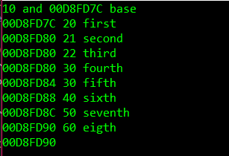
Pointers – incrementing pointers int array[10] = { 10,20,30,40,50,60,70,80,90,100 },
*ptrArray; // ints are 4 bytes
ptrArray = array;
cout << *ptrArray << " and " << ptrArray << " base\n";
cout << ptrArray << ' '; cout << *++ptrArray << " first\n"; //advance ptr, dereference to print
cout << ptrArray << ' '; cout << ++*ptrArray << " second\n"; //dereference & incr value then print
cout << ptrArray << ' '; cout << ++(*ptrArray) << " third\n"; //same as ‘second’
cout << ptrArray << ' '; cout << *(++ptrArray) << " fourth\n"; //same as ‘first’
cout << ptrArray << ' '; cout << *ptrArray++ << " fifth\n"; //dereference to print, advance ptr
cout << ptrArray << ' '; cout << *(ptrArray)++ << " sixth\n"; //same as fifth
cout << ptrArray << ' '; cout << *(ptrArray++) << " seventh\n"; //same as first
cout << ptrArray << ' '; cout << (*ptrArray)++ << " eigth\n"; //dereference to print, incr value
cout << ptrArray;

Slide 14
Pointers – incrementing pointers, summary *++ptrArray //advance ptr, dereference to get value
*(++ptrArray)
*(ptrArray++)
++*ptrArray //dereference & incr value then get value
++(*ptrArray)
*ptrArray++ //dereference to get value, advance ptr
*(ptrArray)++
(*ptrArray)++ //dereference to get value, incr value

Slide 15
Pointers – passing parameters into main
int main(int argc, const char * argv[]) // used to pass arguments into main
int main(int argc, const char * * argv)

Slide 16
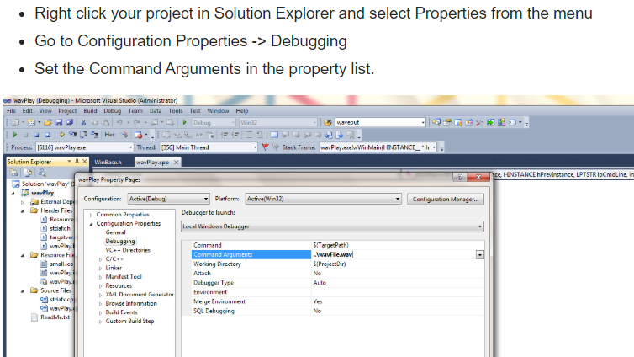
Pointers – passing parameters into main
to set your arguments in Visual Studio

Slide 17
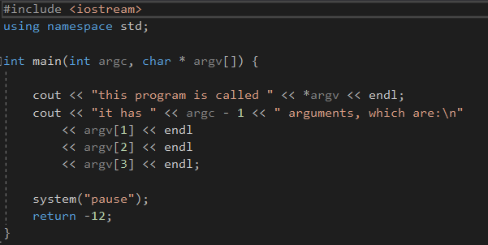
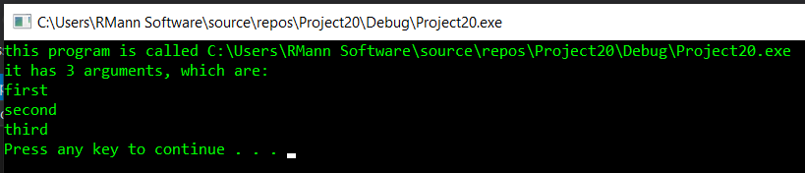
Pointers – passing parameters into main
int main(int argc, const char * argv[]) // used to pass arguments into main
int main(int argc, const char * * argv)

Slide 18
Pointer Errors
Memory leak occurs when new is used and not followed correctly with delete (typically inside destructor)
- extremely difficult to uncover in one’s code
Dangling pointer occurs when pointer is created but not pointed at valid value

Slide 19
Destructor
Simple class:
class Simple { private: int * intPtr; public: Simple() { intPtr = new int; } //example of in-line function definition ~Simple() { delete intPtr; } //needed because new was used inside class, to prevent memory leak
int* getPtr( ) const { return intPtr; } int main() { Simple simple, second; //calls default constructor, which generates new memory for int cout << *(simple.getPtr() ); //intPtr is dangling pointer! (never cleared or assigned) .
.
return( 0 );
} //calls destructor, which should free memory generated in class [manual, not automatic] //program exit frees up memory for all declared variables

Slide 20
Copy Constructor
A special constructor is called when a new object is created and a second object of the same class is assigned to it.

Slide 21
A default copy constructor is called when it hasn’t been overridden (just like a regular constructor)
Copies all values of original object into this object using memberwise assignment

Slide 22
Copy Constructor
Simple class:
class Simple { private: int * intPtr; public: Simple() { intPtr = new int; } ~Simple() { delete intPtr; } int main() { Simple simple, second; //calls default constructor, which generates new memory for int .
. Max( simple ); //pass-by-value . //which duplicates value stored in intPtr (which is an address) and . //destructor frees it when Max exits
.
return( 0 );
} //destructor tries to again free memory pointed to by intPtr but can’t

Slide 23
Copy Constructor
Simple class:
class Simple { private: int * intPtr; public: Simple() { intPtr = new int; } //example of in-line function Simple( const Simple & original ) {intPtr = new int; *intPtr = *(original.intPtr); } //copy constructor ~Simple() { delete intPtr; } int main() { Simple simple; //calls default constructor, which generates new memory for int .
. Max( simple ); //pass-by-value, calls copy constructor . //which duplicates content stored in intPtr and . //destructor frees it when Max exits
.
return( 0 );
} //destructor successfully frees memory pointed to by intPtr

Slide 24
Overload assignment operator
int main() { Simple A, B; A = B; //copies all values in B to A, including pointers //same issue as passing pointers-by-value

Slide 25
Overload assignment operator
Solution: override = operator for the class Simple& Simple::operator=( const Simple& oldObj ) { if (this != &oldObj ) //if not doing A=A { delete intPtr; intPtr = new int; *intPtr = *(oldObj.intPtr); } return *this; }

Slide 26
Rule of Three
If class contains a pointer attribute or otherwise allocates memory 1. create destructor 2. create copy constructor 3. overload assignment operator

Slide 27
Copy constructors are called when
a variable is being initialized from an object of the same class
an object is passed by value to a function
an object is returned by a function
the compiler generates a temporary copy

Slide 28
Dynamic Array Allocation
An ordinary array is statically allocated const int MAX_SIZE = 100 double staticArray[ MAX_SIZE ];

Slide 29
Dynamic Array Allocation
An ordinary array is statically allocated const int MAX_SIZE = 100 double staticArray[ MAX_SIZE ];
Can use new operator to dynamically allocate an array
int arraySize = 100;
double * dynamicArray = new double[ arraySize ];

Slide 30
Dynamic Array Allocation
An ordinary array is statically allocated const int MAX_SIZE = 100 double staticArray[ MAX_SIZE ];
Can use new operator to dynamically allocate an array
int arraySize = 100;
double * dynamicArray = new double[ arraySize ];
delete returns dynamically allocated array to computer for use
delete [] dynamicArray;

Slide 31
Dynamic Array Allocation – increasing size
int arraySize = 100;
double * dynamicArray = new double[ arraySize ];
//To change array’s size, create new, larger array and copy old to new. Then, delete old
double * newArray = new double[ arraySize * 1.5 ];
for (int x = 0; x < arraySize; ++x )
newArray[x] = dynamicArray[x];
delete [] dynamicArray;
dynamicArray = newArray; //so we can continue to use the same variable name
newArray = nullptr; //eliminate dangling pointer possibility
arraySize *= 1.5; //update current array size variable

Slide 32
Memory Allocation for Variables and Early Binding
Declare variable x to have data type int
C++ compiler allocates memory to hold an integer
Use the identifier x to refer to this memory
A function’s locally declared variables
Placed into an activation record with parameters and bookkeeping data
Activation record placed on run-time stack
Activation record destroyed when function finished

Slide 33
Memory Allocation for Variables and Early Binding
Storage for data members of an object
Also placed into an activation record
Data fields placed on the run-time stack just as primitive data types are
This is early binding , made during compilation
Cannot be altered during execution

Slide 34
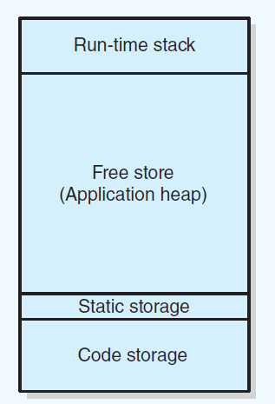
Computer Memory
program memory layout
declared variables (locals), parameters
added by function call removed by function exit
allocated memory
used by new returned by delete
global variables
where program is stored

Slide 35
Smart Pointers was name given when first proposed
Added to language as Managed Pointers
Still in much documentation as Smart Pointers, so used inter-changeably

Slide 36
int * x;
Considered a raw pointer
Programmer has to monitor to ensure delete occurs, if necessary

Slide 37
myStruct * head= new myStruct; //has next ptr
head->next = nullptr;
//insert at beginning of list
mystruct * temp = head; //alias
head = new myStruct;
head->next = temp; //re-connect list
delete temp; //optional, automatic if in function
temp=nullptr; //eliminate dangling pointer

Slide 38
Smart Pointers or Managed Pointers
Object that acts like a raw pointer but with memory management features
deallocation occurs as soon as object not needed
last reference goes out of scope (method or function ends)
value is set to nullptr
do not need to manually delete

Slide 39
Smart Pointers or Managed Pointers
requires #include <memory>
usually only requires small change to allocation statement of standard (raw) pointer
No longer need delete ptr; ptr = nullptr; in code

Slide 40
Smart Pointers or Managed Pointers
shared_ptr
several instances all point to same object.
has attribute for reference counting (how many shared occurrences)
deletes memory when reference count returns to 0
unique_ptr
sole owner of an object
cannot be shared
reference counter can only be 0 or 1
weak_ptr
non-owning reference to an object owned by shared pointer
unable to delete object since it doesn’t own it
used when desired to have two objects reference each other

Slide 41
Raw Pointer code
string * myMagicPtr = new string;
…
delete myMagicPtr;
myMagicPtr = nullptr;
Shared Pointer code
shared_ptr< string > myMagicPtr ( new string );
…
//delete myMagicPtr;
//myMagicPtr = nullptr;

Slide 42
Shared Pointer code
shared_ptr< string > myMagicPtr ( new string );
creates two memory allocations:
explicit with new
implicit with manager object of shared pointer

Slide 43
Shared Pointer code
shared_ptr< string > myMagicPtr ( new string );
creates two memory allocations:
explicit with new
implicit with manager object of shared pointer
instead:
shared_ptr< string > myMagicPtr = make_shared< string>;
is faster and safer due to memory management

Slide 44
Shared Pointer code
shared_ptr< string > myMagicPtr = make_shared< string >;
is cumbersome so can be replaced by auto:
auto myMagicPtr = make_shared<string>;
Lets program determine dynamically the type to use from the initializer

Slide 45
Shared Pointer code
declare a pointer but not an object
( similar to int * ptr; )
shared_ptr<string> myPlainPtr;

Slide 46
Unique Pointer code (examples)
unique_ptr<string> myMagicPtr( new string() );
auto myToyPtr = make_unique<string>();
unique_ptr<string> myFancyPtr;
Notes:
Unique, so no copy constructor is allowed!

Slide 47
Unique Pointer code
since there isn’t (cannot be) a copy constructor, it’s not possible:
myFancyPtr = myMagicPtr;
Must move ownership of object:
myFancyPtr = move(myMagicPtr);
(automatically sets myMagicPtr = nullptr)
Unique pointers can only be passed to functions via reference
Notes:
Unique, so no copy constructor is allowed!

Slide 48
Weak Pointer code
auto sharedPtr1 = make_shared<string>();
weak_ptr<string> weakPtr1 = sharedPtr1;
reference count is only 1 since weak_ptr can’t manage object
cannot use * or -> with a weak pointer

Slide 49
Weak Pointer code
auto sharedPtr1 = make_shared<string>();
weak_ptr<string> weakPtr1 = sharedPtr1;
can use .lock to assign weak_ptr to shared_ptr
shared_ptr<string> sharedPtr3 = weakPtr1.lock();
increases reference count by 1
.lock() returns nullptr if object was already deallocated
can also call weakPtr1.expired() which returns true/false

Slide 50
Weak Pointer code
a doubly-linked list
should have shared_ptr for next
weak_ptr for previous
allows for proper deallocation by destructor

Slide 51
Other Features of Smart Pointers
.reset() passes ownership of parameter object
aPtr.reset( bPtr); //ownership passes from b to a
//equivalent to aPtr = bPtr;
if no parameter sets to nullptr aPtr.reset(); //same as aPtr = nullptr;

Slide 52
Other Features of Smart Pointers
get method, for interacting with legacy raw pointers
returns a raw pointer to the managed object

Slide 53
Methods exclusive to Shared Pointers
unique – returns true if this object is only owner of managed object
use_count – returns reference count of managed object

